Slide 1
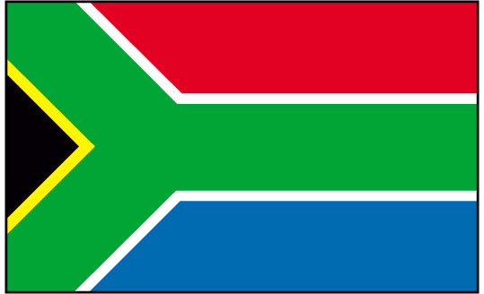
South Africa: Apartheid

Slide 2
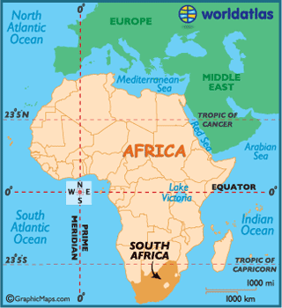
The History…
In 1652, the Dutch set up a trading station in the Cape of Good Hope

Slide 3
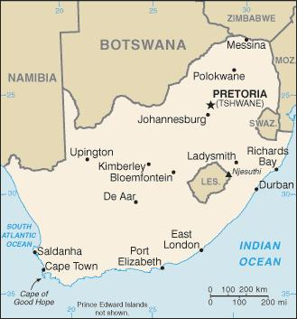
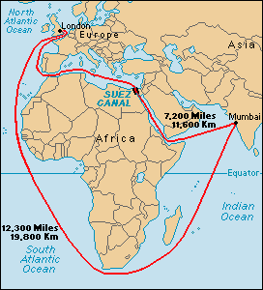
The History Cont.…
The Dutch who were living at the Cape of Good Hope helped to supply their ships sailing from the Netherlands to the East Indies

Slide 4
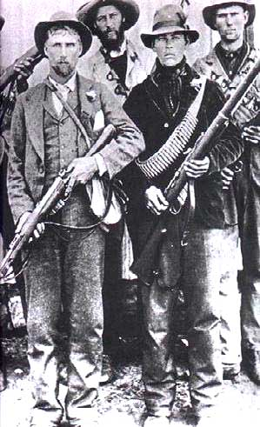
The History Cont.…
Other European groups of people along with the Dutch settled in South Africa
French
Germans
All European settles in South Africa were called Afrikaners

Slide 5
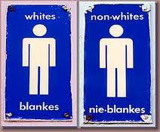
The History…Cont.
Afrikaners = all white people in South Africa
Their official language was: Afrikaans

Slide 6
Life during the Apartheid…
By the 1900’s, much of South Africa had started to become racist and much of the government was dominated by white Afrikaners.
African National Congress (ANC) was created to fight back against the Afrikaners.
This was an uphill battle for black South Africans
Stephen Biko

Slide 7
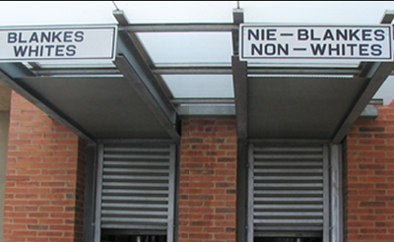
Life during the Apartheid…
Despite the newly formed ANC, racial tensions began to grow and this period of hate and segregation is known as the Apartheid (apart and separate)

Slide 8
Life during the Apartheid…
The government passed various laws that required separation of color. No black Africans or white Afrikaners were allowed to do anything together

Slide 9
Life during the Apartheid…
Black South Africans were not allowed to:
Vote
Receive a good education
Have well-paying jobs
Use the same facilities as white Afrikaners
Visit the same hospitals or restaurants, or use the same transportation
In addition they had to:
Married couples had to have state permission to live together
Carry identification papers with them at all times

Slide 10
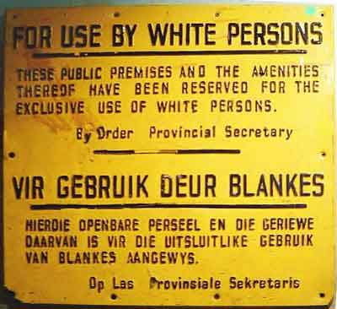

Slide 11
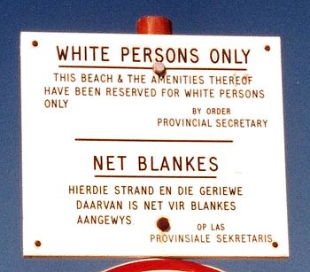

Slide 12
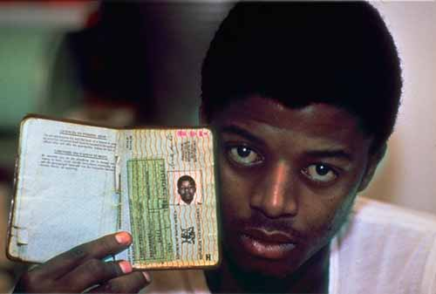

Slide 13
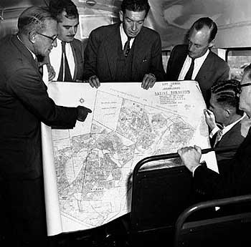
Notes:
Figuring out which areas of the towns in S.A. would be deemed “black” and “white”

Slide 14
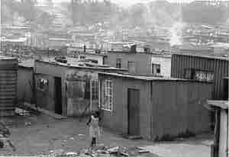

Slide 15
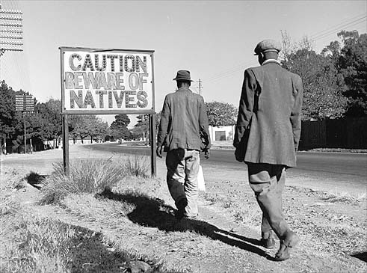

Slide 16
Apartheid Timeline
1948: Apartheid Begins
1959: Vietnam War Starts
1975: Vietnam War Ends
1992: Clinton Elected US President
1955: US Civil Rights Movement Begins
1968:
US Civil Rights Movement Ends
1989: Berlin Wall falls
1994: Apartheid Ends

Slide 17
Life during the Apartheid…
Most power, least numbers
Whites
Least power, most numbers
Asians
Coloreds
Blacks
Notes:
Colored: mixed race, Malayan
Asian: Pakistani, Indian

Slide 18
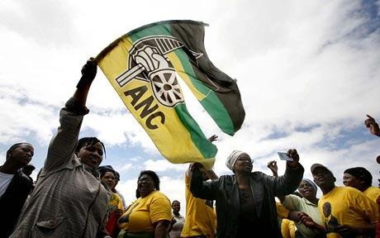
How Did it End?
The international community began to exclude South Africa from global events
Economic and political “punishments”
Countries refused to trade with S.A.
Internal protests
Nelson Mandela
First Black African to be elected president of South Africa

Slide 19
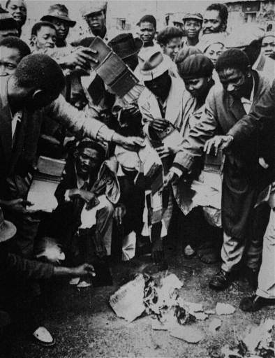
Notes:
Burning ID papers

Slide 20
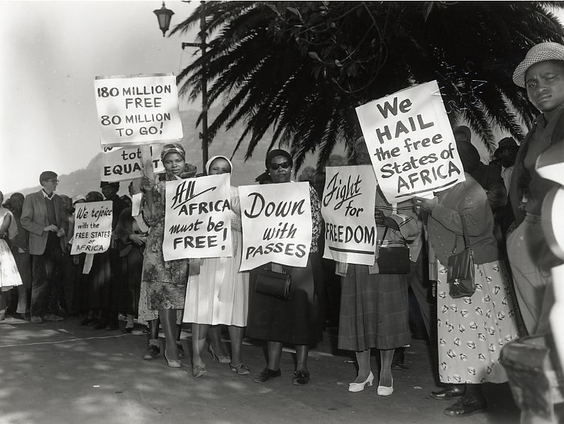

Slide 21
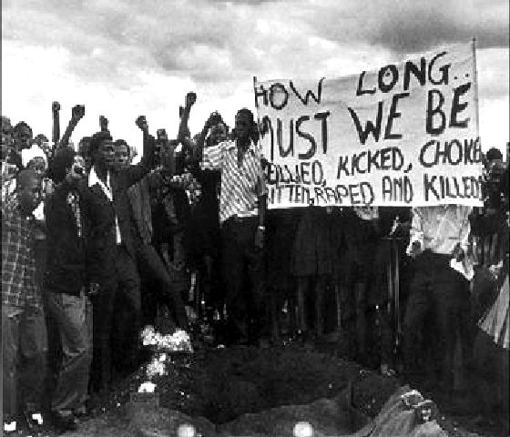

Slide 22
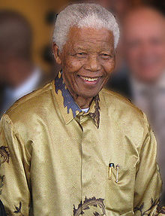
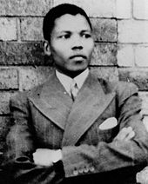
Nelson Mandela
Born July 18, 1918
Given name: Rolihlahla (Troublemaker) Mandela
His English teacher gave him the name “Nelson”
His father influenced him to study to become a lawyer
Became heavily involved in anti-apartheid movements in the 1950s and 60s

Slide 23
Nelson Mandela Cont…
In 1961, he became the president of the ANC – which he co-founded
He quickly realized that non-violent measures were not going to stop the apartheid so he made other arrangements:
Sabotage campaigns
Bombing apartheid courts, post offices, and government offices
Raised funds from outside the country to train his ANC troops

Slide 24
Nelson Mandela’s Arrest
August 5, 1962 Mandela was arrested after being on the run for 17 months
He was sent to prison for 27 years and he spent 18 of those years on Robben Island penitentiary
His reputation grew in prison as an influential leader in S.A.
Prisoners were segregated by race
Mandela was allowed one letter and visitor every 6 months

Slide 25
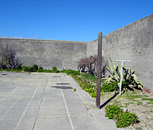
Yard at Robben Island Prison

Slide 26
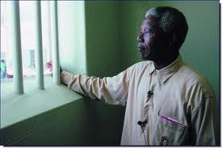
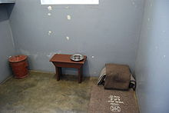

Slide 27
Mandela’s Release
February 11 1990, Mandela was released from prison
1991 F.W. de Klerk (white president of S.A. reversed the ban on the ANC, and repealed the apartheid laws)
From 1990-94 he returned to the ANC and assisted in holding S.A.’s first multi-racial election – which he won
Throughout his presidency he continued to rebuild S.A. and advocate for social and human rights organizations

Slide 28
